Slide 1
wetHa x year x region
wetHa x month x region

Slide 2
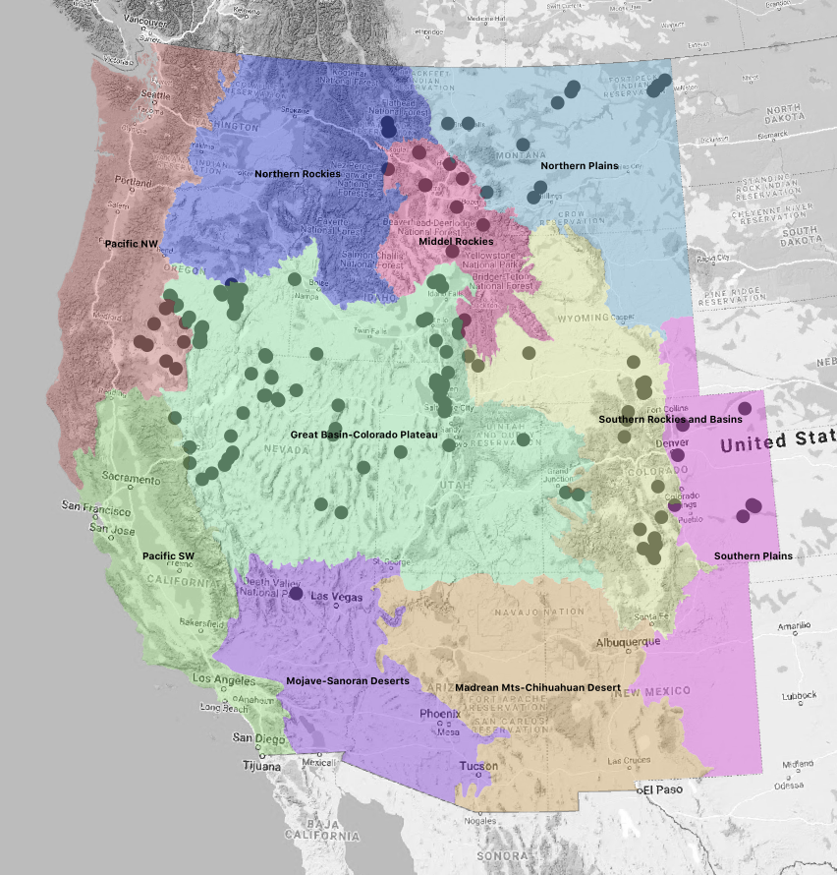
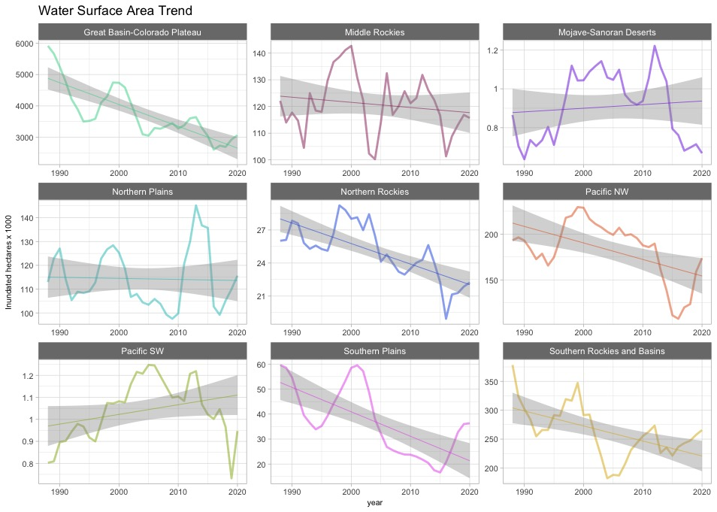

Slide 3
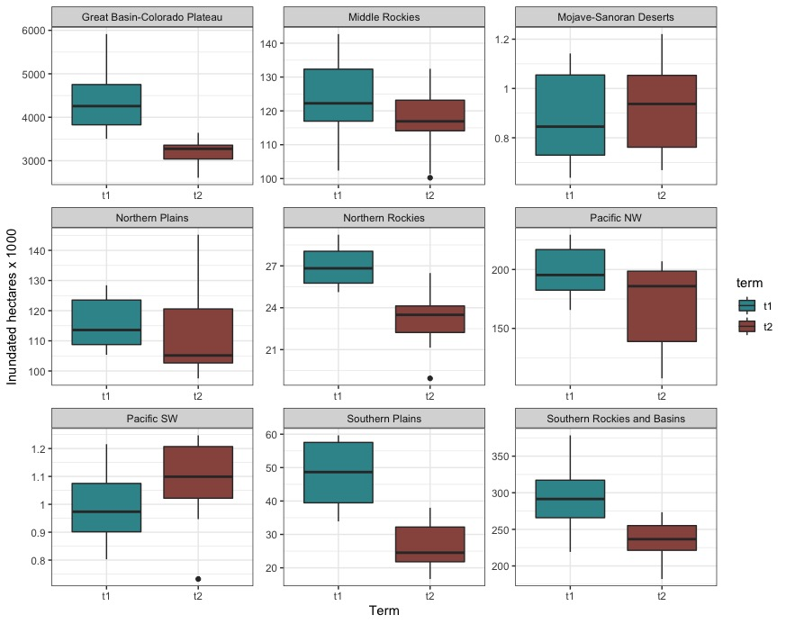
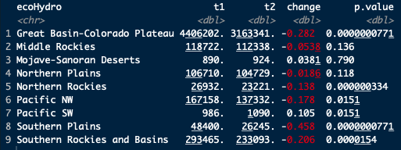
Overall wetHa Changes

Slide 4
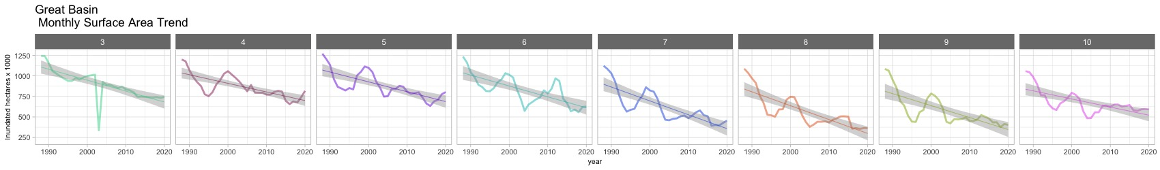
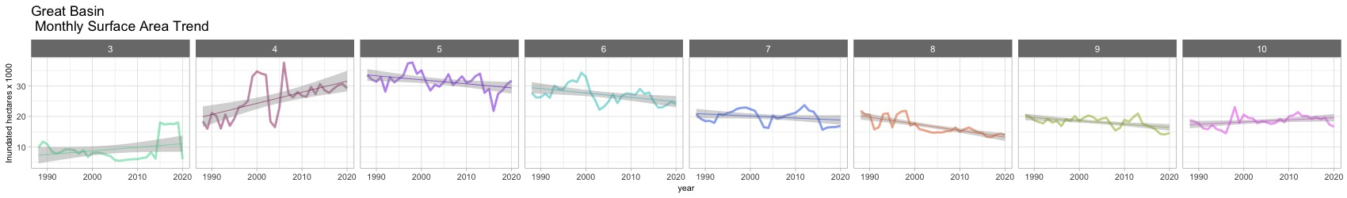
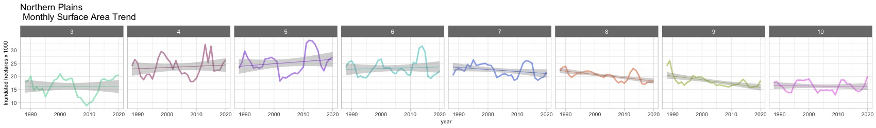
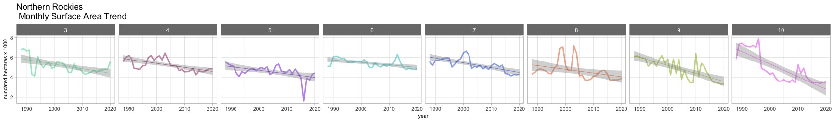
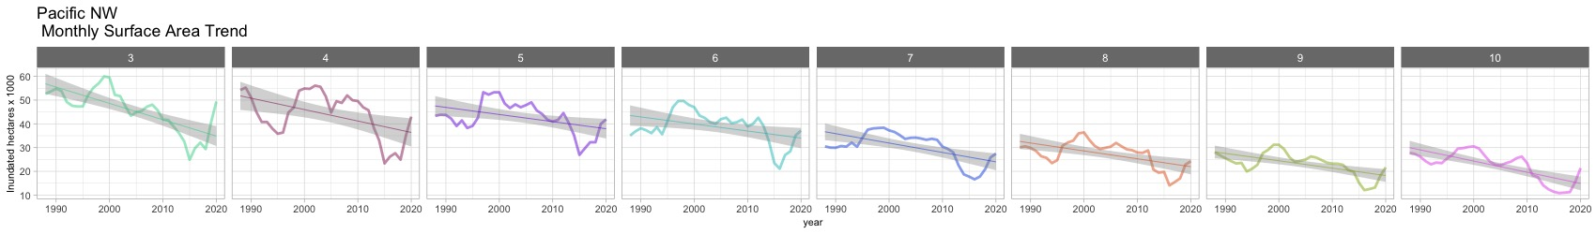
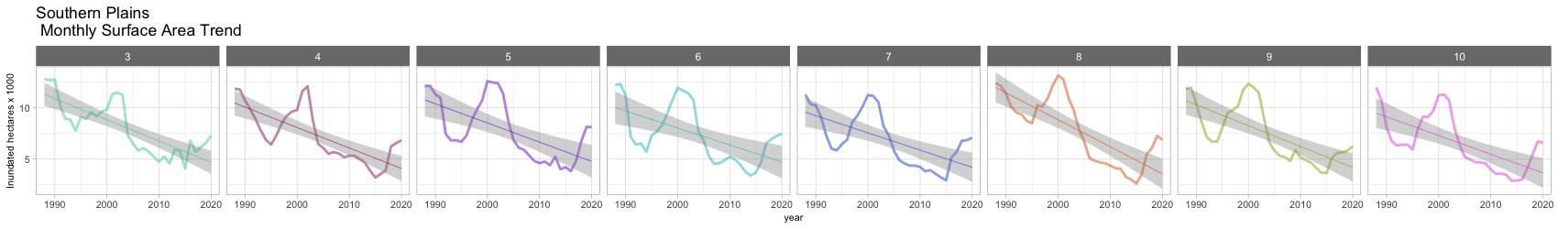
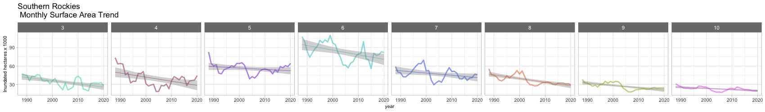
wetHa trend for each month for each region
Great Basin
-19%
-19%
-22.%
-25%
-39%
-41%
-36%
-23%
+10%
-22%
-9%
+7%
Mid Rockies
+16%
-7%
-11%
-6%
-11%
-14%
-4%
N. Plains
-2%
+5%
-3%
-8%
-9%
-15%
-18%
-24%
-35%
N. Rockies
-15%
-10%
-8%
-16%
-24%
-21%
-24%
-39%
Pacific NW
-27%
-17%
-14%
-16%
S. Plains
-44%
-53%
-47%
-48%
-43%
-45%
-43%
-42%
-24%
-26%
-13%
-16%
-30%
-30%
-15%
S. Rockies
-21%

Slide 5
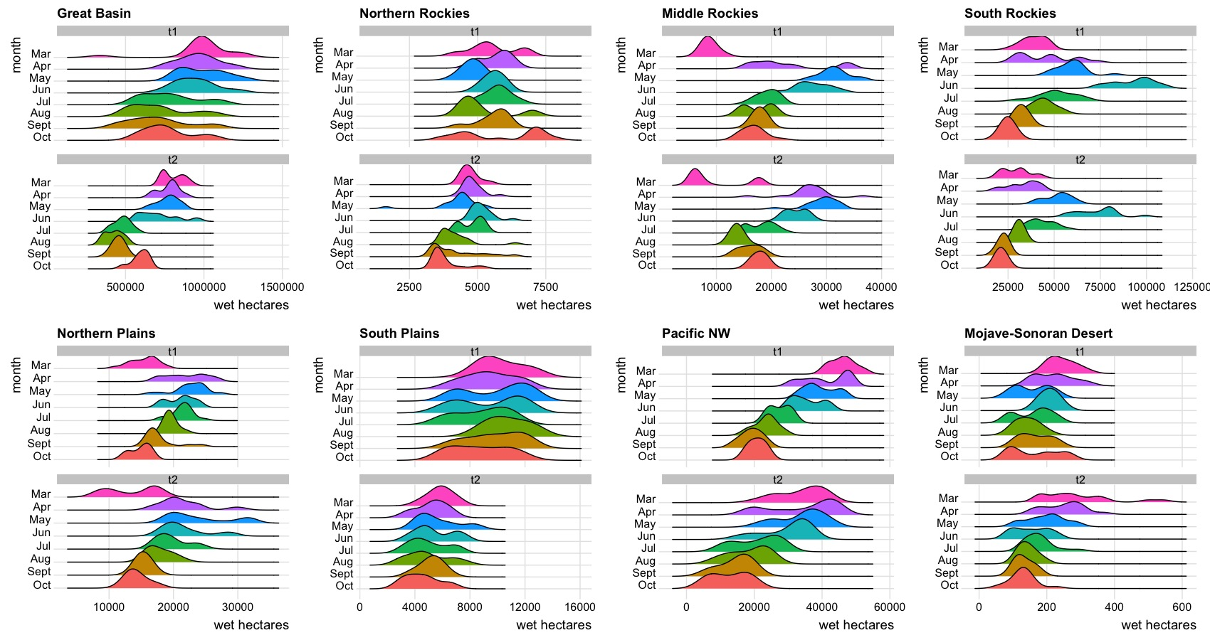

Slide 6
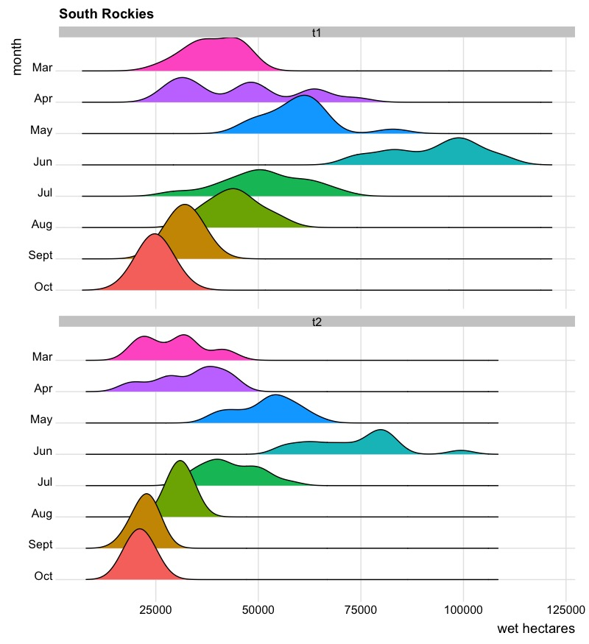

Slide 7
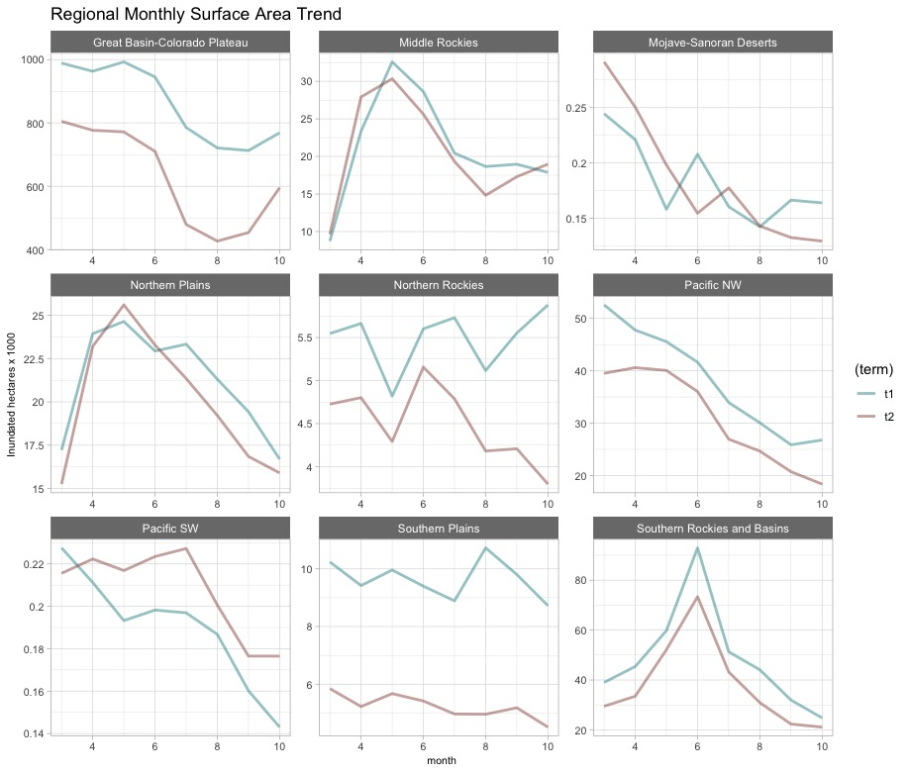

Slide 8
Ownership Surface Water Trends
T1 = 1988 – 2003 (rolling medians)
T2 = 2004 – 2020 (rolling medians)
Apr -- Aug

Slide 9
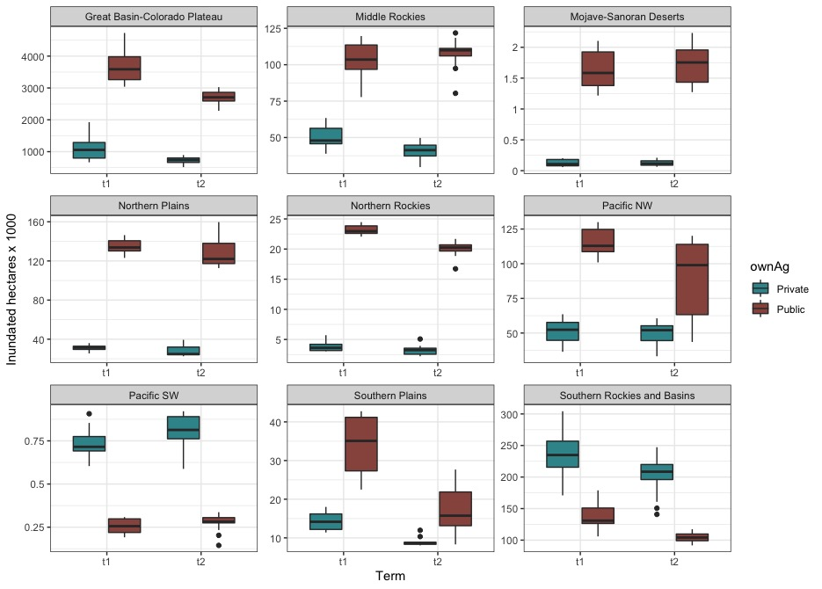
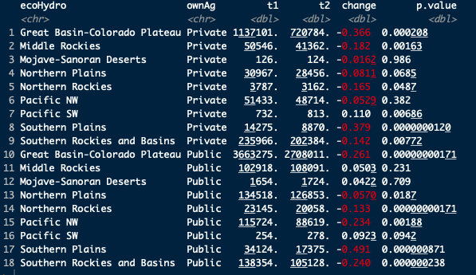
Differences between Private and Public from T1 to T2

Slide 10
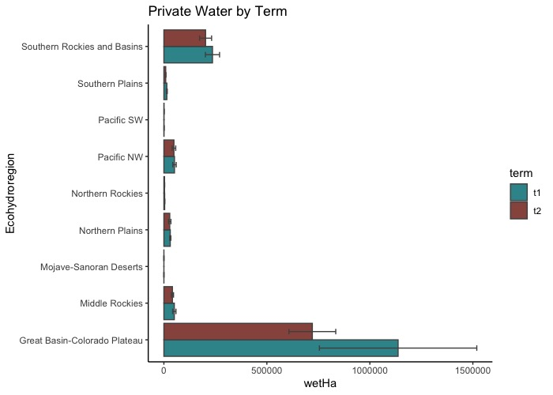
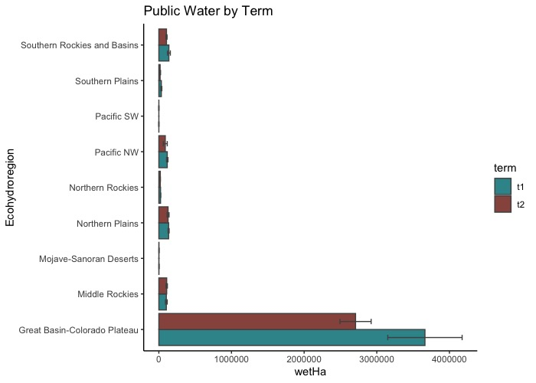

Slide 11
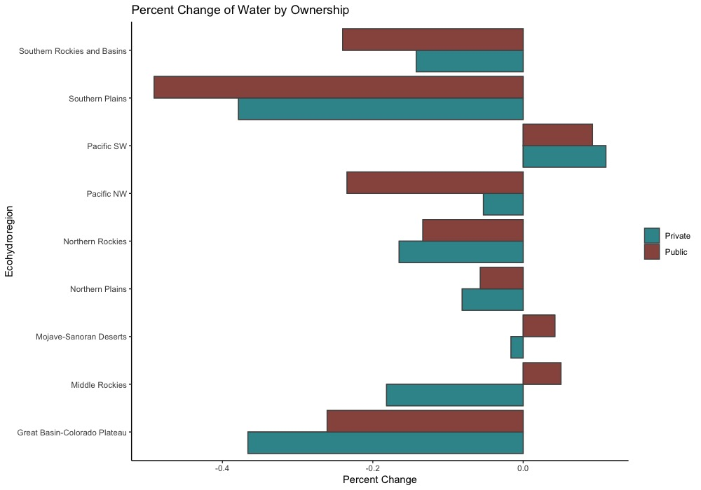
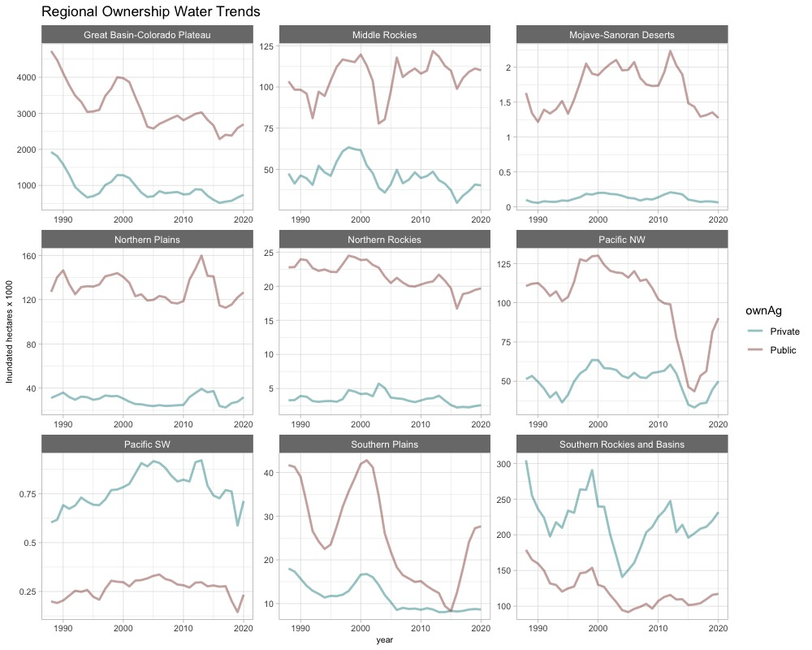
Private vs Public
Apr – Aug
1984-2020

Slide 12
Hydroperiod Surface Water Trends

Slide 13
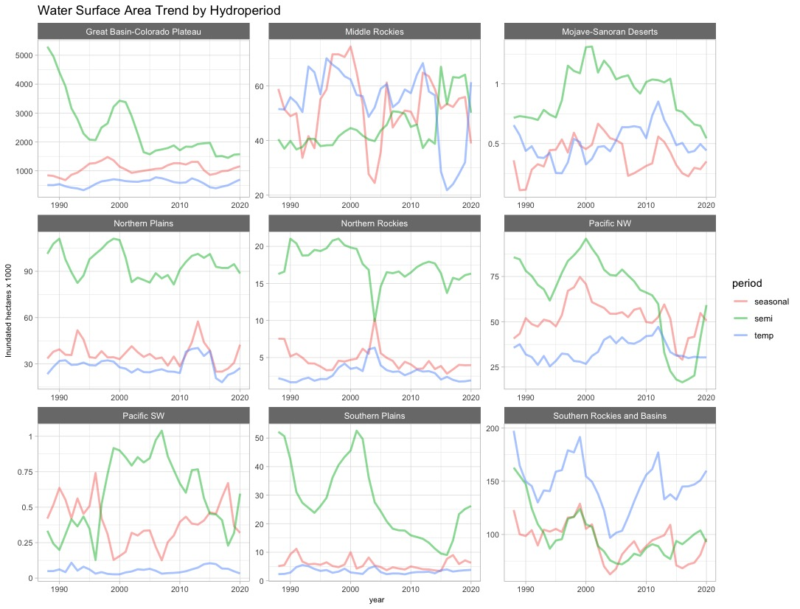

Slide 14
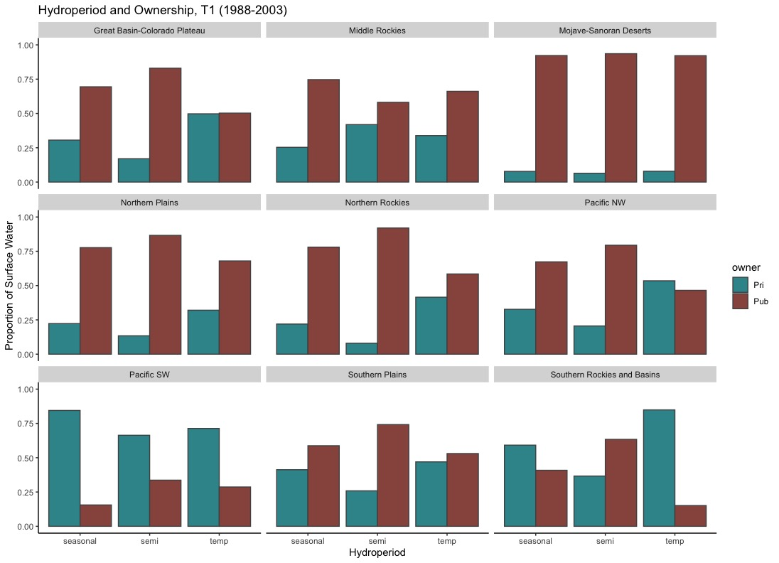
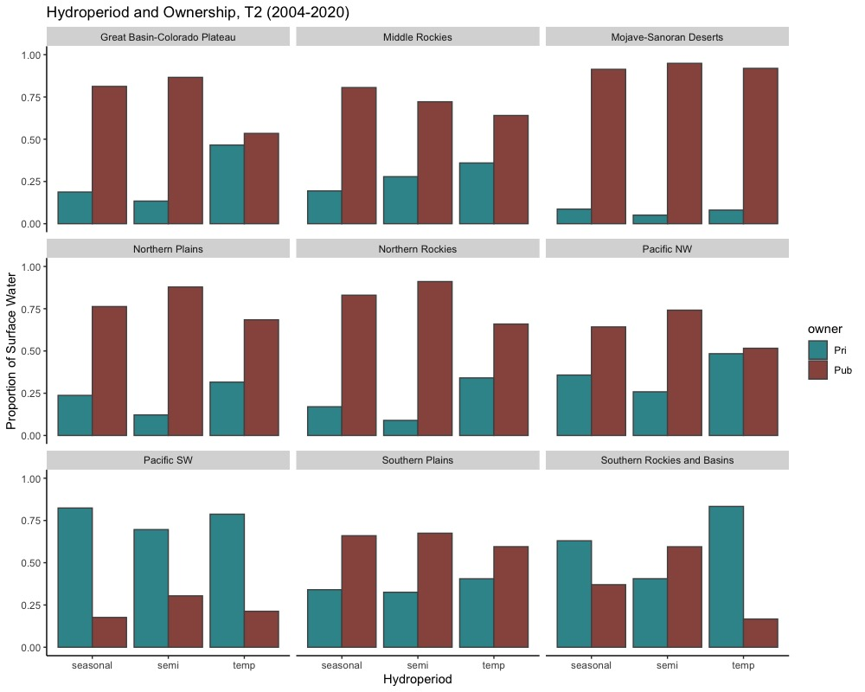

Slide 15
WetType Surface Water Trends

Slide 16
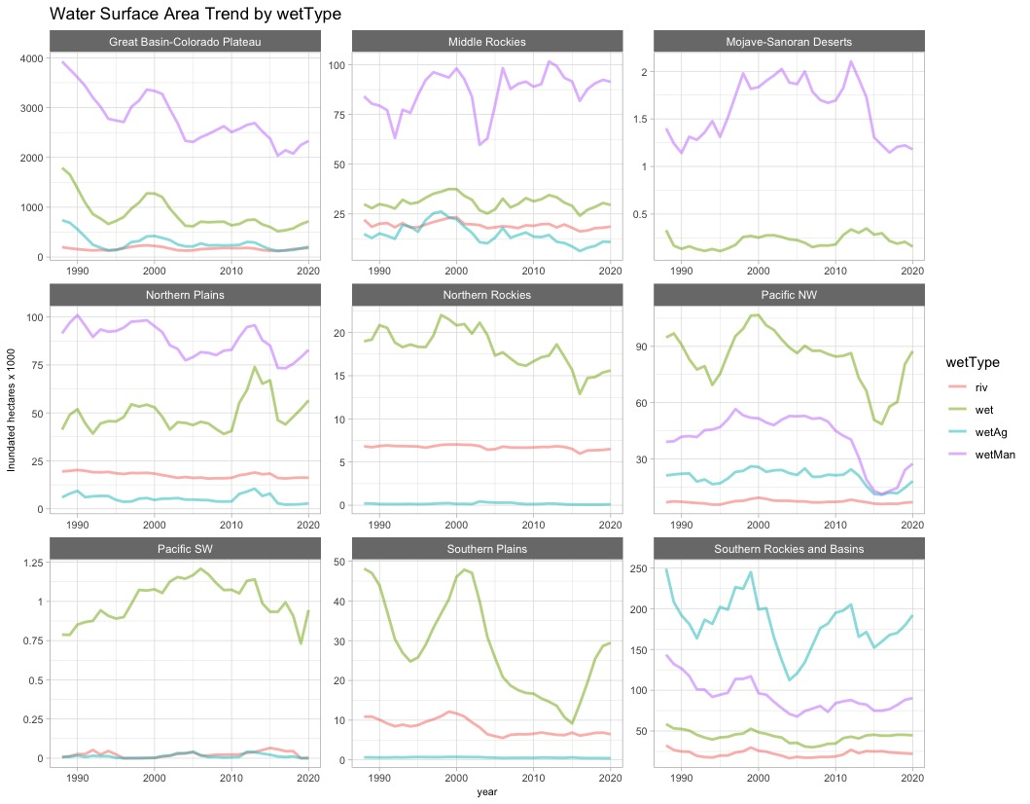

Slide 17
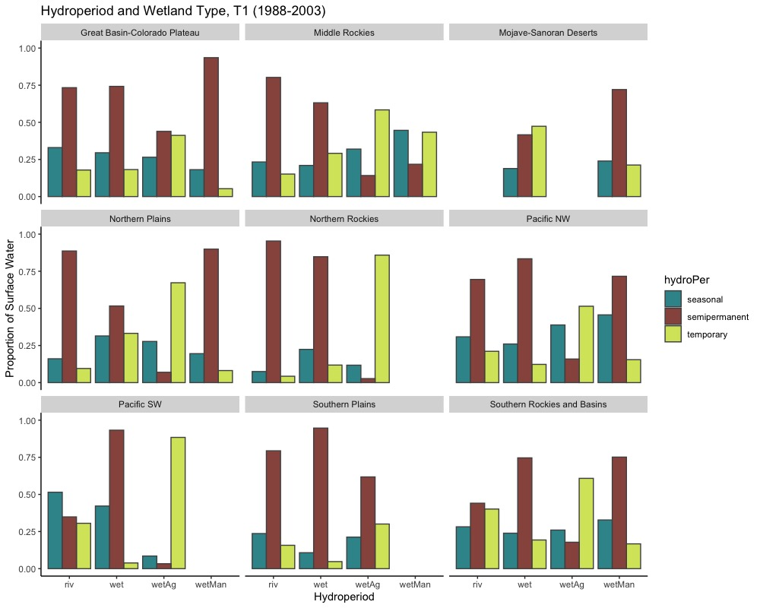
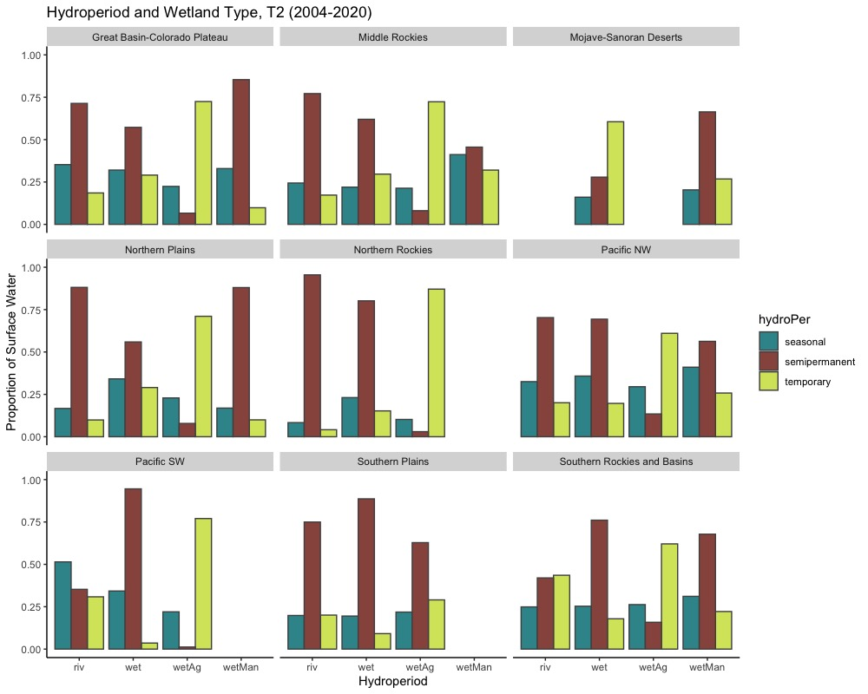

Slide 18
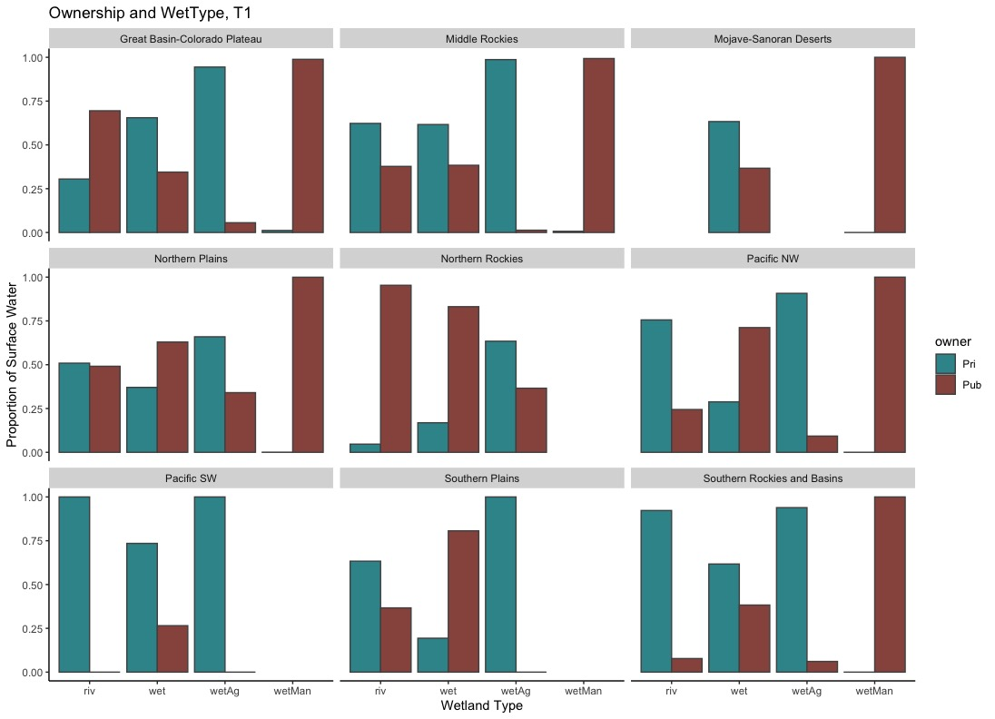


Slide 19
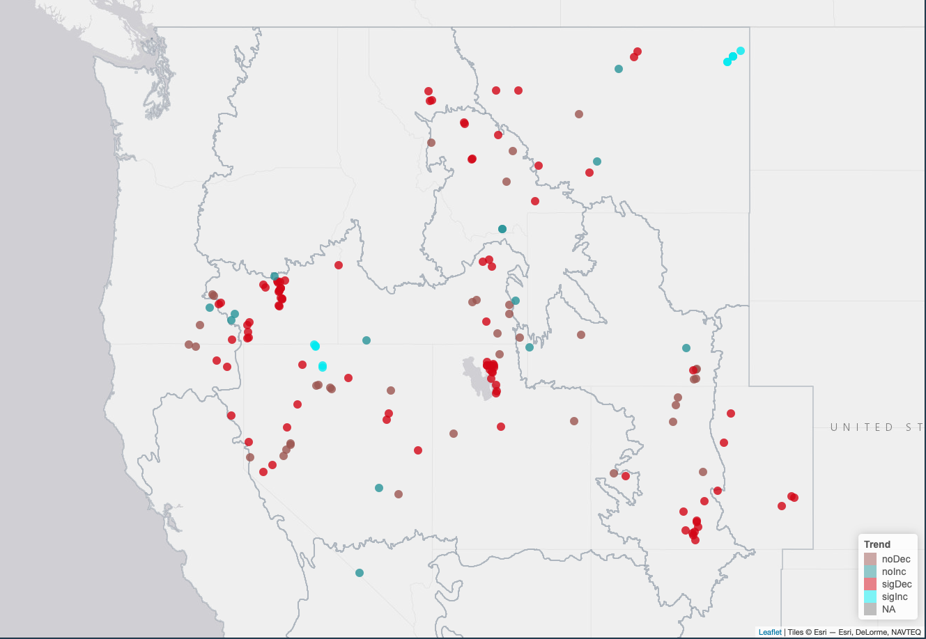
Ibis sites overall water trends

Slide 20
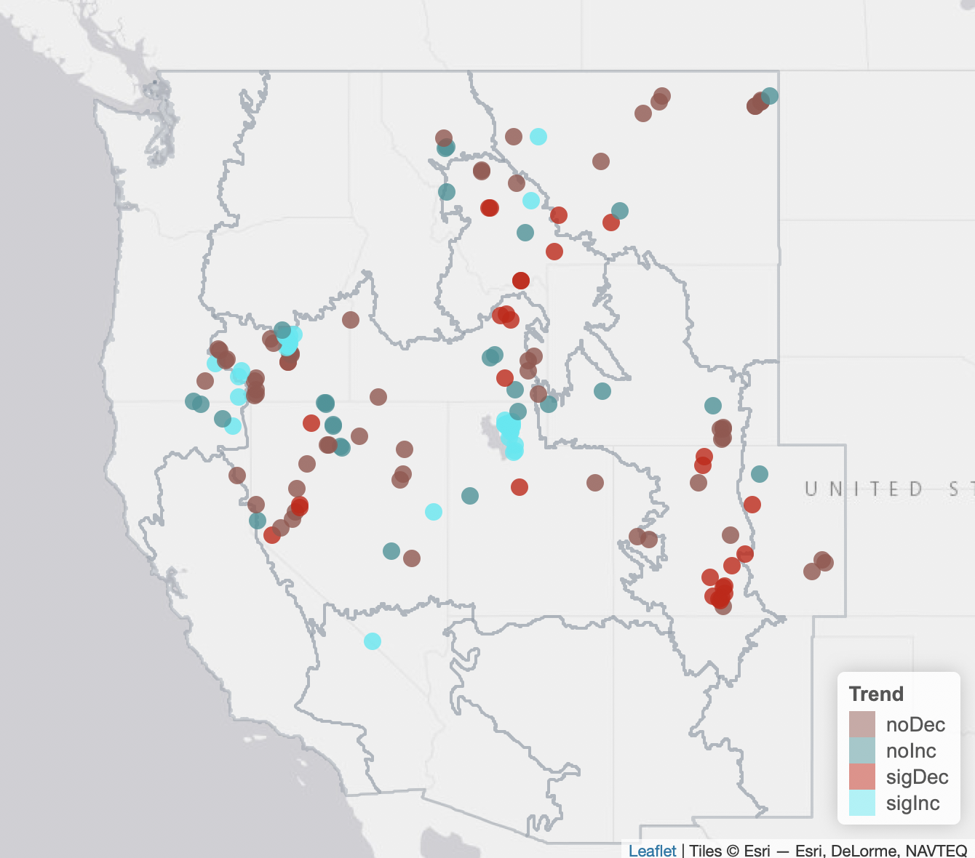
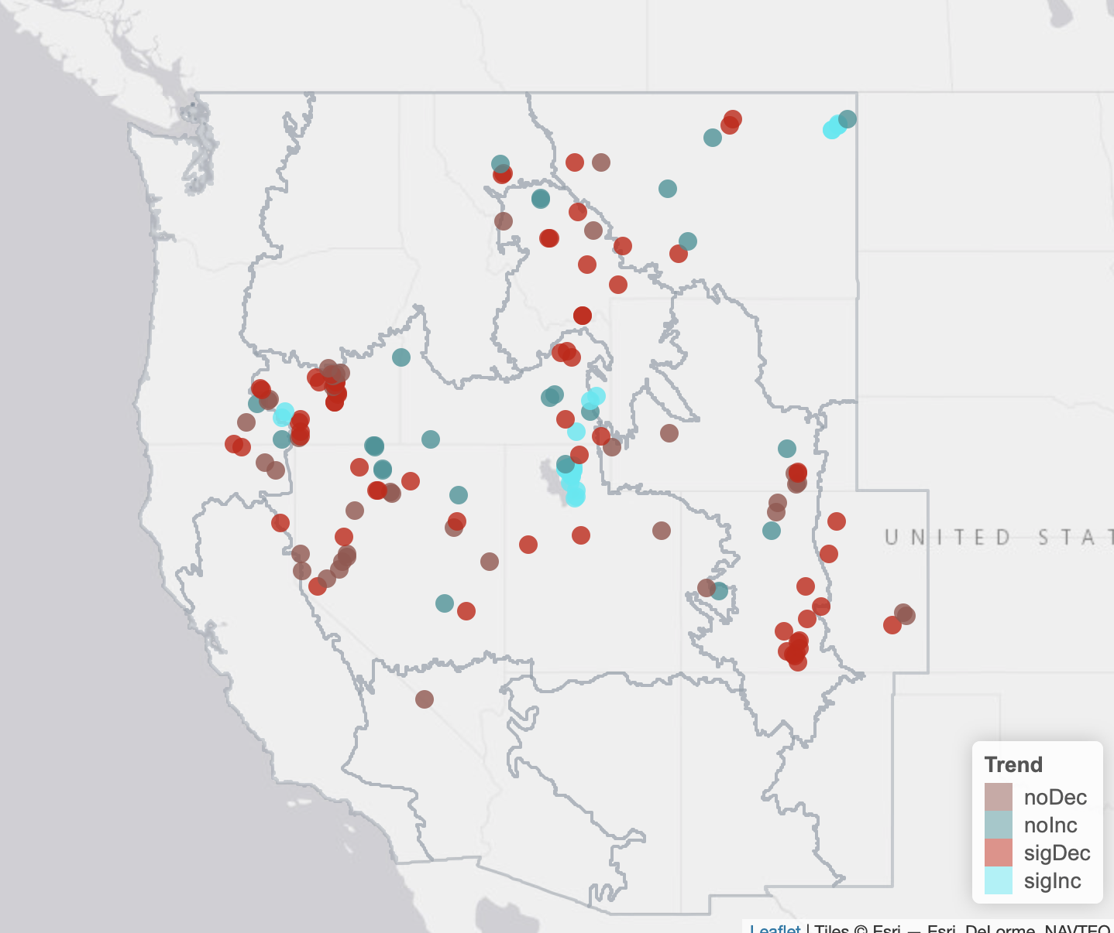
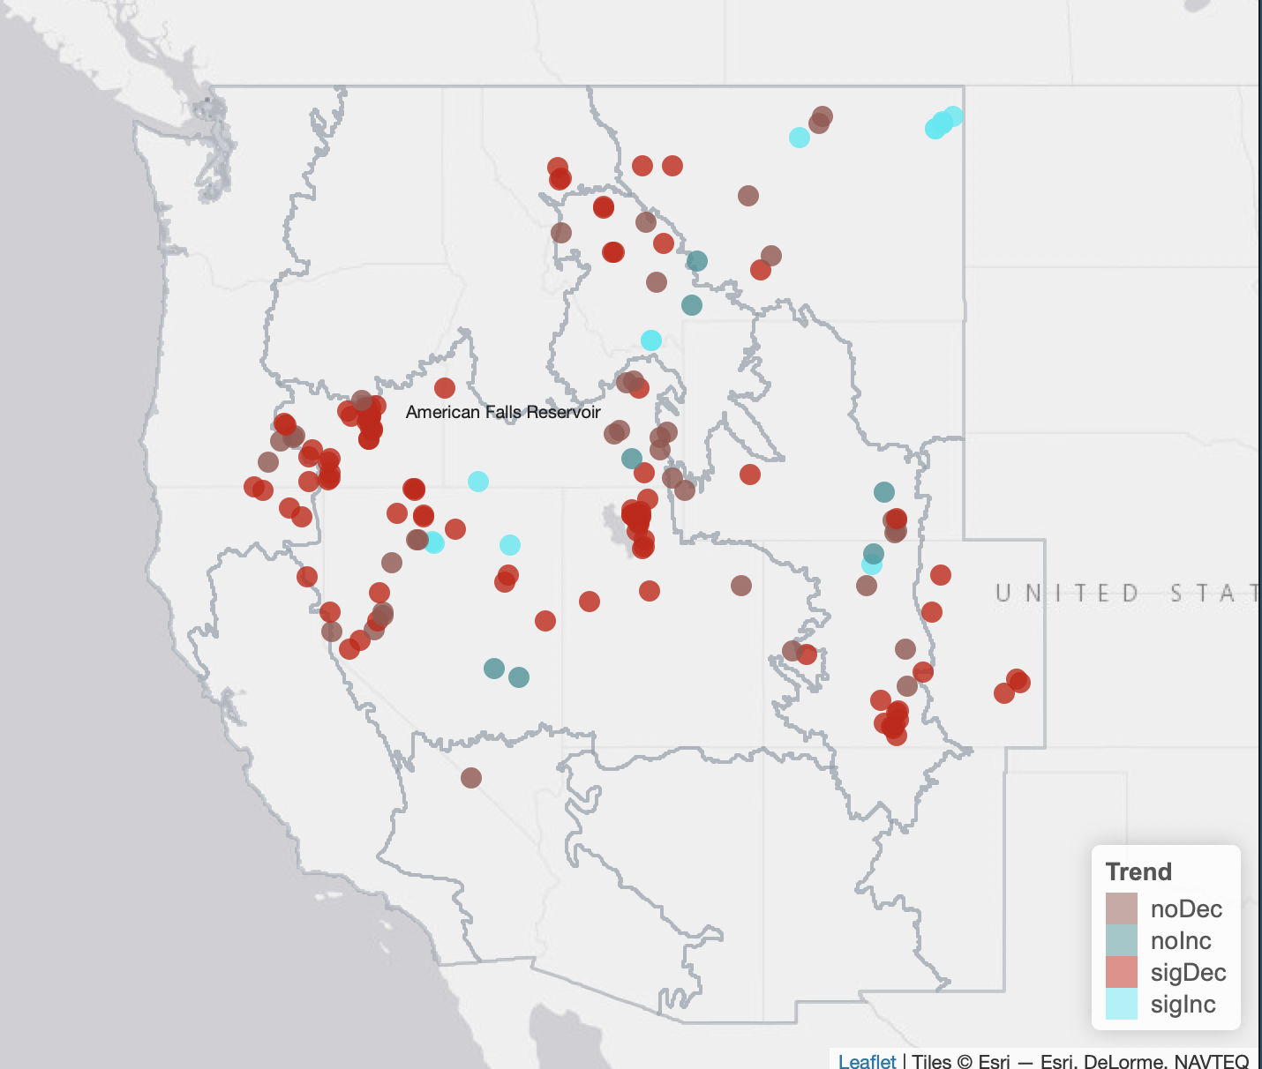
Hydroperiod trends at ibis colony locations
temp
seasonal
Semi-perm

Slide 21
Climate data

Slide 22
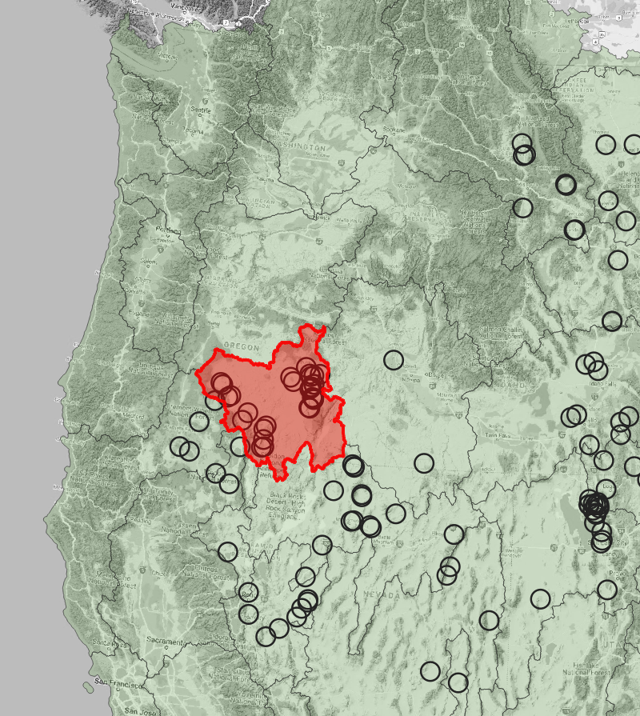
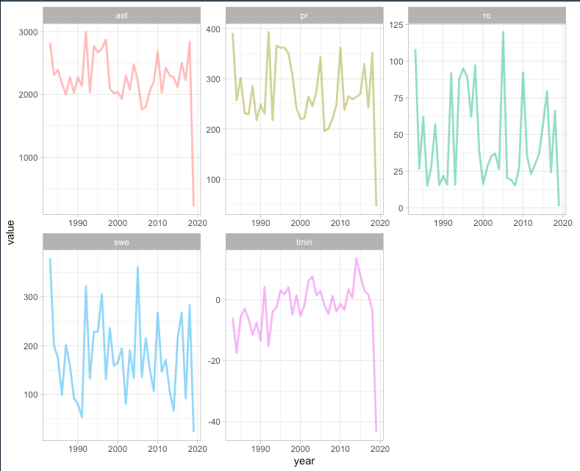

Slide 23
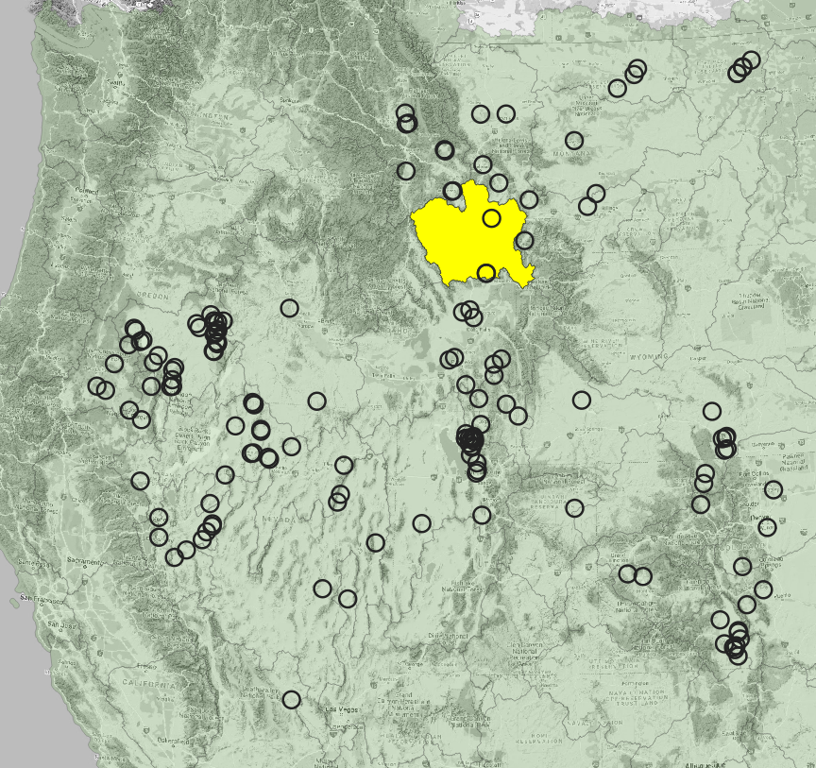
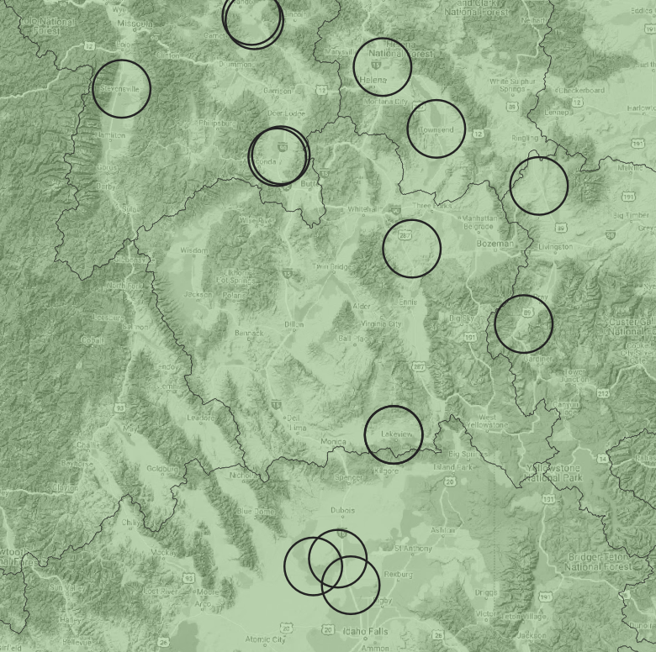

Slide 24
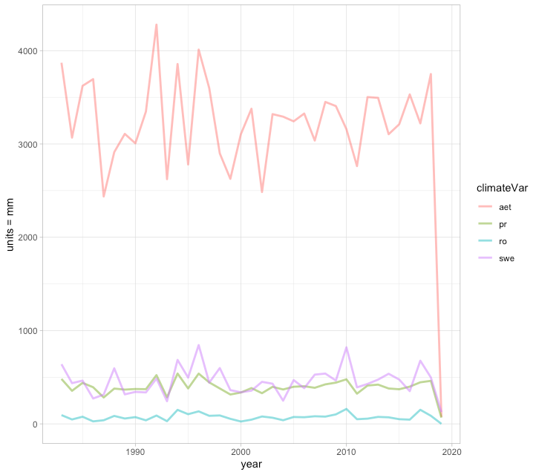
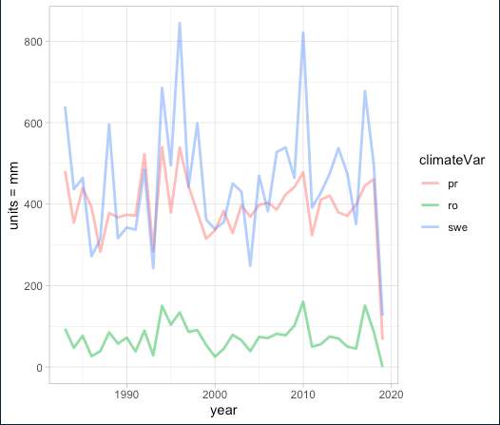
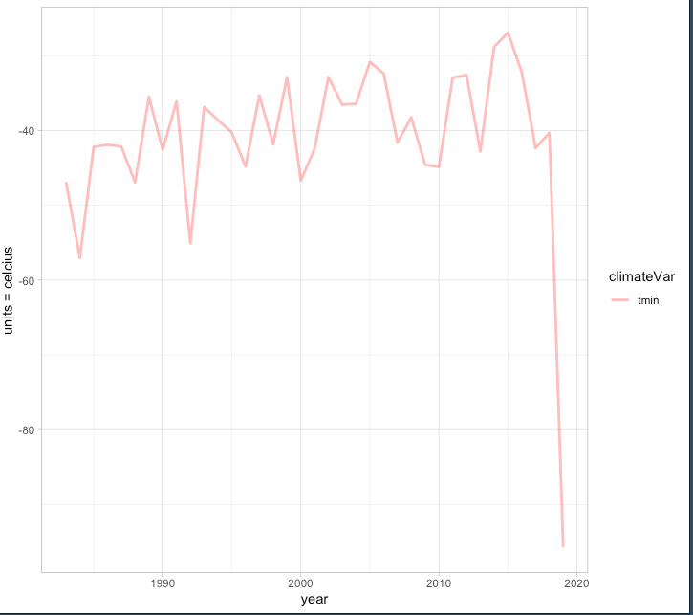
Notes:
One HUC (HUC 1002)

Slide 25
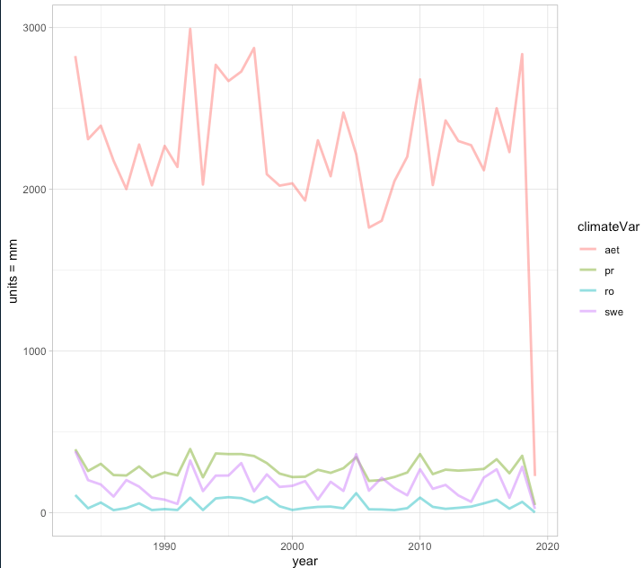
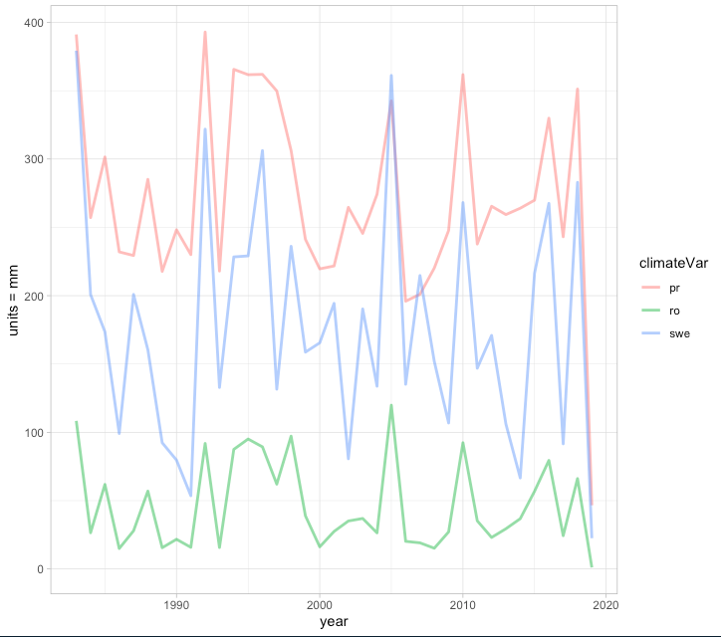
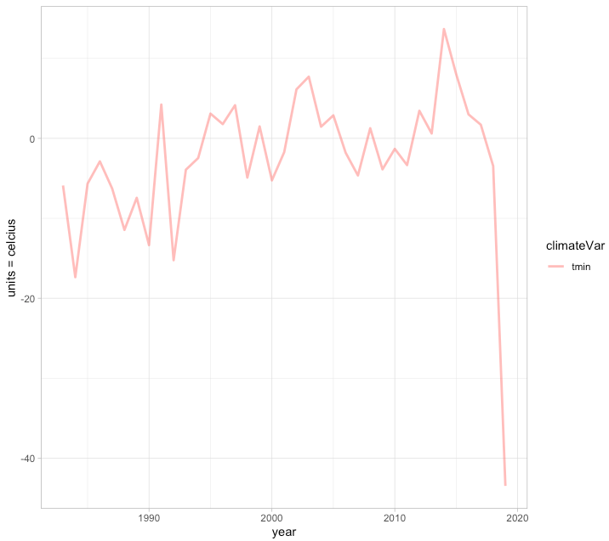

Slide 26
Trends by Region (percent change, differences between first period and second)
Overall
Monthly
Ownership
Wetland Type
Hydroperiod
Trends by Site
Overall
Hydroperiod
Proportions by Region
Ownership
Wetland Type
Hydroperiod
Climate Data
Tmin
SWE
PR
AET
RO

Slide 27
Random Forest with Annual data

Slide 28
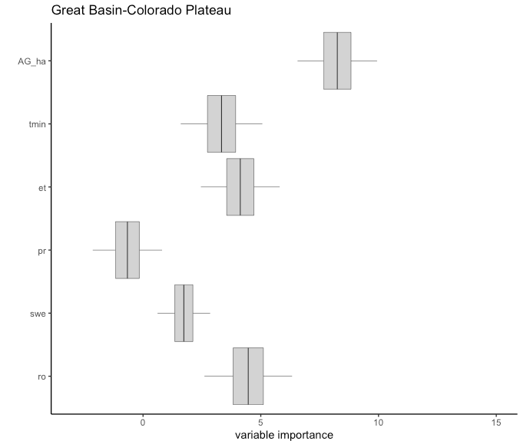
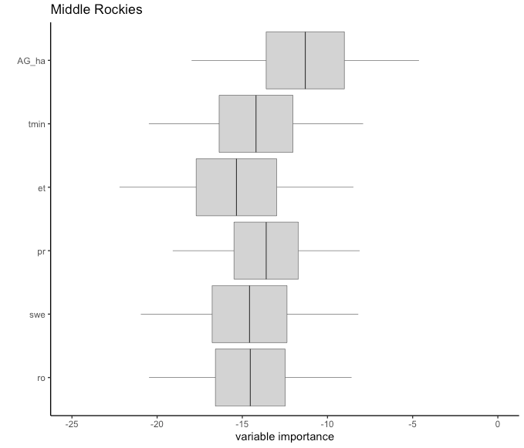
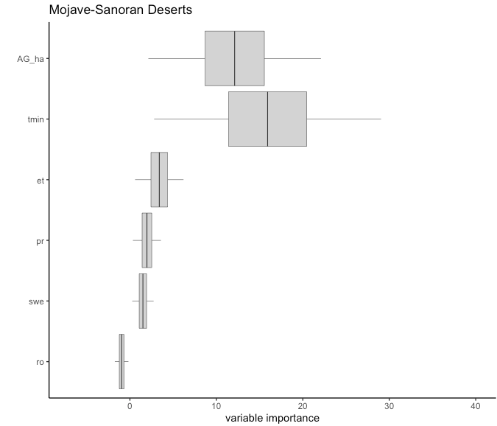
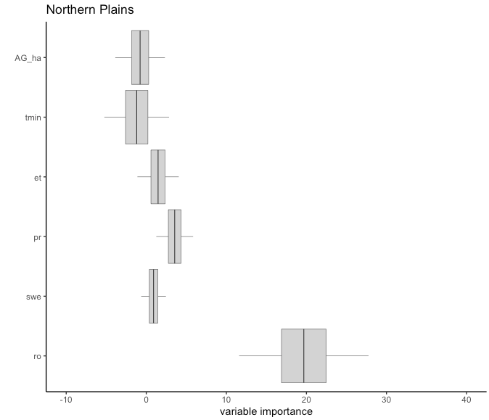
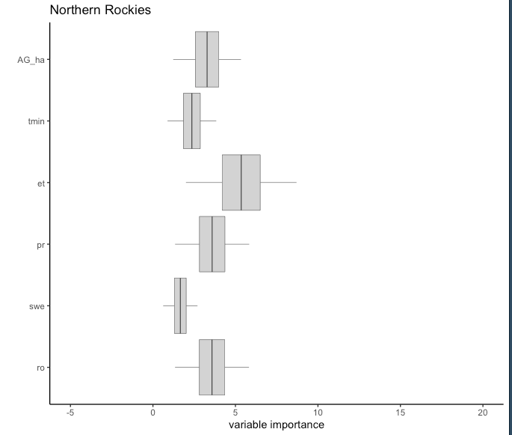
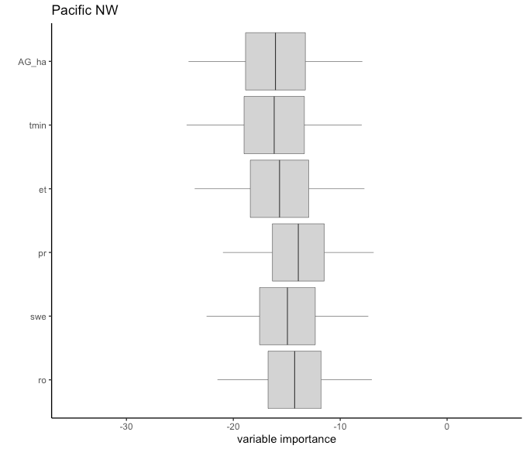
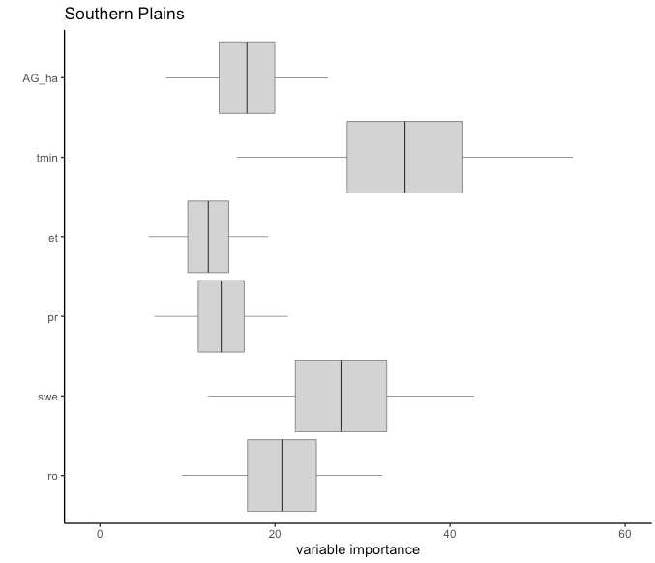
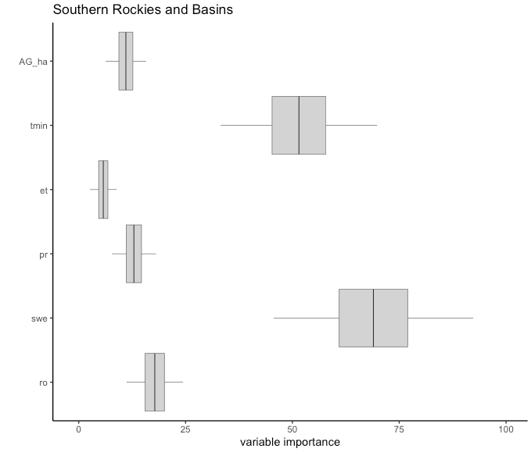

Slide 29
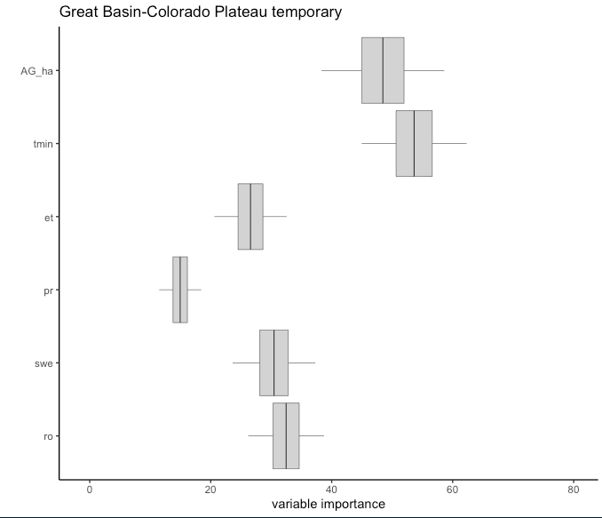



Slide 31
Random Forest with Seasonal data

Slide 32




Notes:
More clear relationships with seasonal data. Example: Middle Rockies

Slide 33





Slide 34
Random Forest for Hydroperiods by region

Slide 35



Great Basin

Slide 36



Middle Rockies

Slide 37



Mojave

Slide 38



Northern Plains

Slide 39



Northern Rockies

Slide 40



Pacific NW

Slide 41



Southern Plains

Slide 42



Southern Rockies

Slide 43
NEW RF (duplicate polygons removed)

Slide 44




Great Basin

Slide 45




Southern Rockies

Slide 46




Pacific NW

Slide 47




Middle Rockies

Slide 48




Mojave-Sonoran Deserts

Slide 49




Northern Plains

Slide 50




Northern Rockies

Slide 51




Southern Plains

